Slide 1

Sequential Models
in NLP

Slide 2
Understanding Sequential Data
Working with Sequential Data
Understanding Recurrent Neural Network
Long Short Term Memory (LSTM)
Working with Time Series Data
Language Modeling using RNN

Slide 3
Sequence to Sequence Models
Attention Mechanism
Gated Recurrent Unit

Slide 4

Working with Sequences

Slide 5
The sky is ?

Slide 6
I was born in the state of Maharashtra in India. I studied in my village school till 10th grade and then completed my graduation in Mumbai. Currently I have my own business in IT. I am very fluent in speaking ???

Slide 7
I had washed my house.
I had my house washed.
Exact same words.. but different meaning.
Why?

Slide 8
Sequential Data
Order of data points is important
Number of data points in a sequence can vary

Slide 9





Speech
Text
Music
Protein & DNA Sequence
Monthly Demand data
Some examples of Sequential Data

Slide 10

What kind of applications we can build using Sequential data?
Let’s review some examples

Slide 11


Slide 12

Help us write better
Improved communication

Slide 13
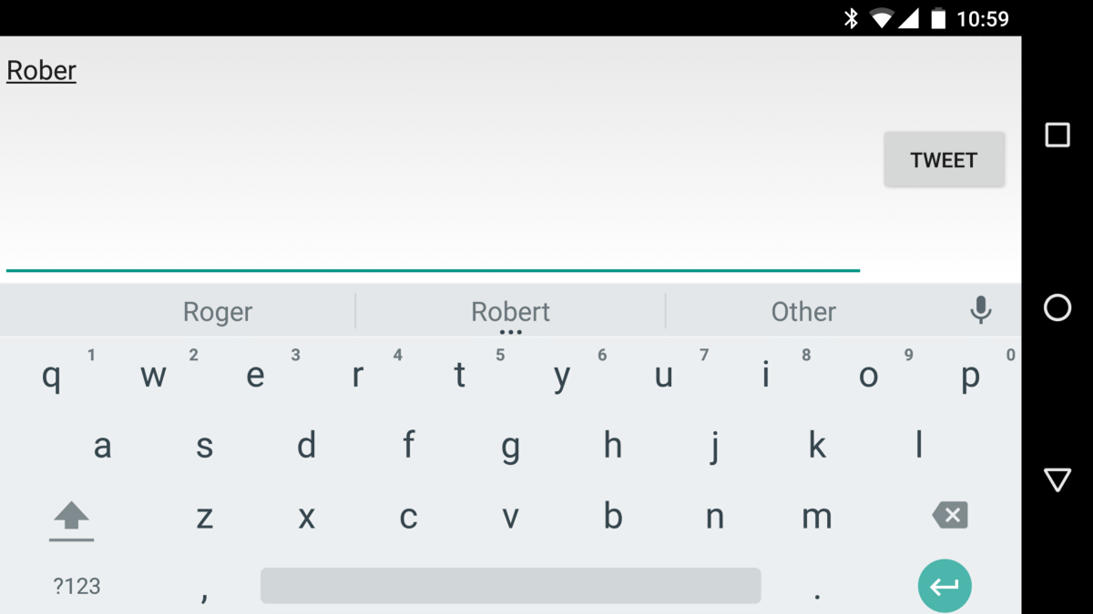
Mobile phone keyboard
Predict next word(s) as we type in...

Slide 14

Convert Speech to Text
e.g Alexa, Siri, Google Home

Slide 15
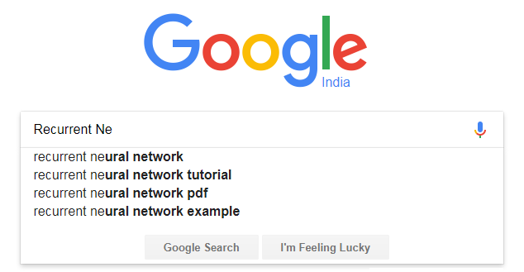
Search suggestions

Slide 16
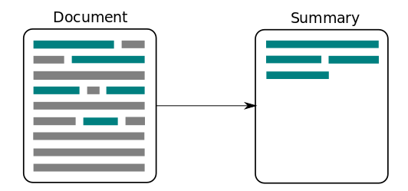
Text Summarization

Slide 17
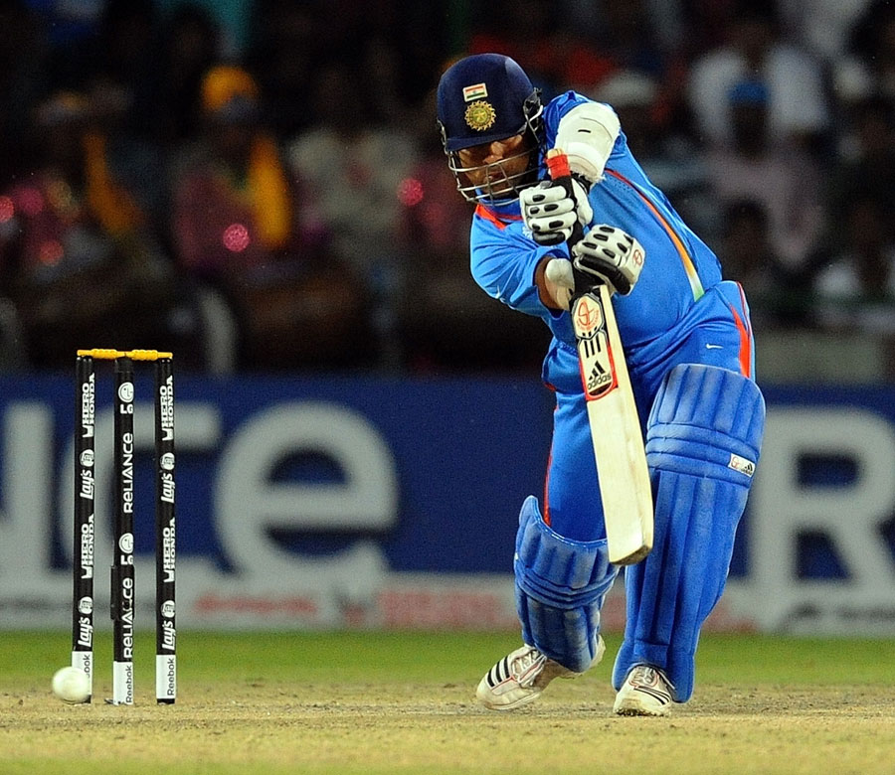
Describe a picture
Tendulkar playing cricket

Slide 18
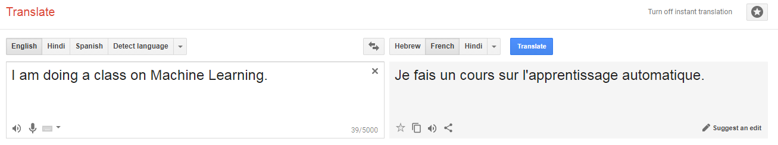
Language Translation

Slide 19
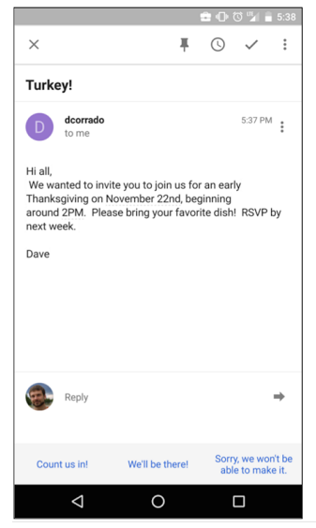
How to provide a response to Email?
Suggested Answers

Slide 20

Demand forecasting
How much to build

Slide 21
How do we make Machines understand ...Sequential Data?
Let’s take an example

Slide 22
The rain just stopped and the sky is
? .
How do we help machine predict the next word?

Slide 23
Language Modeling
Task of predicting the next word
(given earlier words)

Slide 24

A Language Model at Work

Slide 25
How to build a Language Model?

Slide 26
Feed forward
Neural Network
Input
‘The rain stopped and the sky is’
Clear?
Feed forward (Dense) network
Do we need to do anything here?

Slide 27
Feed forward
Neural Network
Input
‘The rain stopped and the sky is’
Tokenize
‘The’, ‘rain’, ‘stopped’, ‘and’, ‘the’ ‘sky’, ‘is’
Vectorize
(Convert words to Numbers)
Clear?
Feed forward (Dense) network

Slide 28
What approach are available for vectorization?
Count Vectorizer
TF-IDF
One hot encoding
Word2Vec

Slide 29
What approach will work with Sequential Data?
Count Vectorizer
TF-IDF
One hot encoding
Word2Vec
Word2Vec is most popular approach for vectorization of sequential data

Slide 30
Let’s take 50 as embedding size
The
Embedding
50 numbers for every word
rain
Embedding
Concat Layer
Hidden Layer
(Dense)
Hidden Layer
(Dense)
Hidden Layer
(Dense)
Output Layer
stopped
Embedding
350
numbers
Clear?
and
Embedding
the
Embedding
sky
Embedding
Feed forward network
With Word2Vec embeddings
is
Embedding

Slide 31
Let’s take 50 as embedding size
The
Embedding
50 numbers for every word
Number of weights?
rain
Embedding
Concat Layer
Hidden Layer
(Dense)
200 Neurons
Hidden Layer
(Dense)
Hidden Layer
(Dense)
Output Layer
stopped
Embedding
350
numbers
Clear?
and
Embedding
the
Embedding
350*200
sky
Embedding
Feed forward network
With Word2Vec embeddings
is
Embedding

Slide 32
Let’s take 50 as embedding size
The
Embedding
These 200 feature outputs represent model’s understanding of 7 words after first Dense layer
50 numbers for every word
200 Outputs
rain
Embedding
Concat Layer
Hidden Layer
(Dense)
200 Neurons
Hidden Layer
(Dense)
Hidden Layer
(Dense)
Output Layer
stopped
Embedding
350
numbers
Clear?
and
Embedding
the
Embedding
sky
Embedding
Feed forward network
With Word2Vec embeddings
is
Embedding

Slide 33
But...what if our sequence has more words?
e.g instead of ‘The rain has stopped and the sky is’
We now have … ‘The rain stopped after a while and the sky is’
We will need to change the model
We can set input words limit to be little higher e.g 100 words

Slide 34
If we set input limit higher e.g 100 words...
then number of weights in 1st Dense layer will be
100 words x 50 numbers for each word x 200 neurons
1,000,000
Number of weights increase as we increase number of input words

Slide 35
We need a new layer . . .
Which can work with sequence of different lengths
Number of weights should not change with number of inputs (words)
How do we build such a layer?

Slide 36
Why Dense layer uses more weights when sequence length increases?
Because a neuron looks at all the input words (features) in Dense layer at once

Slide 37

What if Neuron looks at only one word at a time?
… and remembers what it has looked so far?

Slide 38
RNN : A new kind of Neural network
Can remember sequences and has memory

Slide 39
RNN uses its memory to understand a sequence
RNN
S_{t-1}
Previous memory
No knowledge of sequence to start with
RNN only looks at one input (e.g 1 word) at a time.
X_{t=0}
The
Input at step t=0

Slide 40
RNN uses its memory to understand a sequence
Inputs for RNN?
A word
Previous memory
RNN
S_{t-1}
Previous memory
No knowledge of sequence to start with
X_{t=0}
RNN only looks at one input (e.g 1 word) at a time.
The
Input at step t=0

Slide 41
An input allows the model to start building it’s memory OR knowledge base
RNN
S_{t-1}
S_{t}
Previous memory
No knowledge of sequence to start with
Knowledge of ‘The’ in memory
X_{t=0}
The
Input at step t=0

Slide 42
As model get to see next data element in the sequence, it continues to update it’s memory.
RNN
S_{t}
S_{t+1}
Knowledge of
‘The’
Knowledge of
‘The’, ‘rain’
X_{t+1}
rain

Slide 43
. . . we iterate over this process . . .
RNN
S_{t+1}
S_{t+2}
Knowledge of
‘The’, ‘rain’
Knowledge of
‘The’, ‘rain’, ‘stopped’
X_{t+2}
stopped

Slide 44
. . . and again . . .
RNN
S_{t+2}
S_{t+3}
Knowledge of
‘The’, ‘rain’, ‘stopped’
Knowledge of
‘The’, ‘rain’, ‘stopped’, ‘and’
X_{t+3}
and

Slide 45
Once all the input words have been fed… RNN’s memory will have understanding of the entire sequence!!!
RNN
S_{t+5}
S_{t+6}
Knowledge of
The, rain, stopped, and, the, sky
Knowledge of
The, rain, stopped, and, the, sky, is
Final memory (or state) represents feature output of RNN for given sequence.
X_{t+6}
is

Slide 46
Once all the input words have been fed, we can use final memory state to generate output through output layer
Output Layer
(Dense)
RNN
S_{t+5}
S_{t+6}
Clear?
Knowledge of
The, rain, stopped, and, the, sky
Knowledge of
The, rain, stopped, and, the, sky, is
X_{t+6}
is

Slide 47
RNN over multiple time-steps
O/P Layer
(Dense)
RNN
RNN
RNN
RNN
S_{t-1}
S_{t}
S_{t+1}
S_{t+2}
S_{t+6}
Clear?
Knowledge of
the
Knowledge of
The, rain
Knowledge of
The, rain, stopped
Knowledge of
The, rain, stopped,, and,the, sky, is
X_{t}
X_{t+1}
X_{t+2}
X_{t+6}
The
rain
stopped
is
RNN will build knowledge of sequence over time.

Slide 48
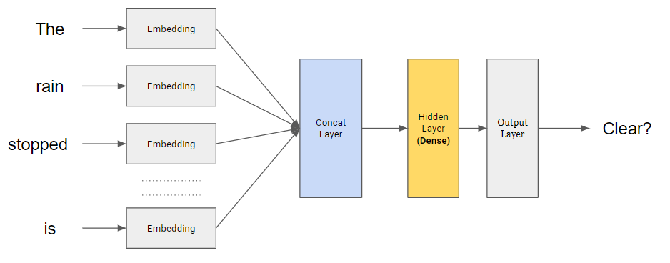
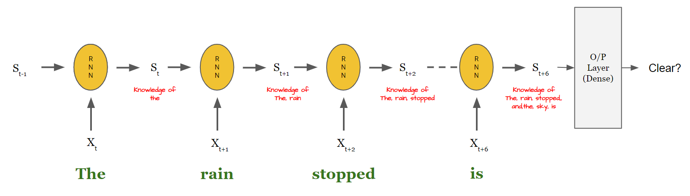
Dense Neural Network (DNN)
Recurrent Neural Network (RNN)

Slide 49
Dense Neural Network (DNN)
How many outputs do we get?
Recurrent Neural Network (RNN)

Slide 50
How many outputs do we get from Dense layer?
It’s a hyper-parameter e.g 200 outputs

Slide 51
Dense Neural Network (DNN)
200 outputs
200
Neurons
Recurrent Neural Network (RNN)

Slide 52
How many outputs from Recurrent layer?
It’s a hyper-parameter
(size of RNN state or memory)
e.g 200 outputs

Slide 53
Dense Neural Network (DNN)
At every time step, RNN memory size remains same e.g. 200 in this case. The values in memory keeps changing with new input.
200
Neurons
200 outputs
200
numbers
200
numbers
200
numbers
200
numbers
Recurrent Neural Network (RNN)

Slide 54

How RNN builds it’s memory?
Math of RNN

Slide 55
RNN Cell
Previous
Memory
Updated memory
S_{t-1}
Dense
+
Tanh
(or ReLU)
S_{t}
At every time step, RNN has two inputs
Dense
x_{t}
Input
e.g word

Slide 56
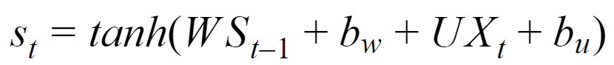
RNN Cell
Previous
Memory
Updated memory
Weights → W
S_{t-1}
Dense
+
tanh
S_{t}
WS_{t-1} + b_{W}
UX_{t} + b_{U}
Dense
Weights → U
x_{t}
Input
e.g word

Slide 57
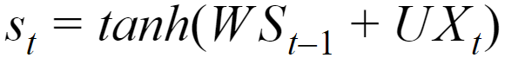
RNN Cell
Previous
Memory
Updated memory
Weights → W
S_{t-1}
Dense
+
tanh
S_{t}
Size of U & W?
WS_{t-1} + b_{W}
UX_{t} + b_{U}
Let's assume size of ...
RNN State (S) → [ 200, 1 ]
Input word embedding (X) → [ 50, 1 ]
Dense
Weights → U
x_{t}
Use matrix multiplication rules to calculate size of U and W
Input
e.g word

Slide 58
RNN Cell
Previous
Memory
Updated memory
Weights → W
S_{t-1}
Dense
+
tanh
S_{t}
Size of U & W?
WS_{t-1} + b_{W}
UX_{t} + b_{U}
Let's assume size of ...
RNN State (S) → [ 200, 1 ]
Input word embedding (X) → [ 50, 1 ]
Dense
Weights → U
x_{t}
Use matrix multiplication rules to calculate size of U and W
Input
e.g word
U → [ 200, 50 ]
W → [ 200, 200 ]

Slide 59
O/P Layer
(Dense)
RNN
RNN
RNN
RNN
S_{t-1}
S_{t}
S_{t+1}
S_{t+2}
S_{t+6}
Clear?
Knowledge of
the
Knowledge of
The, rain
Knowledge of
The, rain, stopped
Knowledge of
The, rain, stopped,, and,the, sky, is
X_{t}
X_{t+1}
X_{t+2}
X_{t+6}
The
rain
stopped
is
Weights of RNN (U, W) remain same at all time steps

Slide 60
When do we update weights of RNN?
Gradient Descent during model training!

Slide 61
Expected Output
Loss
Gradient Descent
Model Output
O
V
W
W
W
W
S_{t-1}
S_{t}
S_{t+1}
S_{t+2}
S_{t+3}
U
U
U
U
X_{t}
X_{t+1}
X_{t+2}
X_{t+3}
Calculate Loss
We can take output at each time step or at last time step

Slide 62
How do we calculate gradient of Loss function w.r.t weights of RNN e.g. W
We have to see how Loss and ‘W’ are related. Then use chain rule.

Slide 63
How is Loss related to W?
Loss —> O_{t+3} —> S_{t+3} —> S_{t+2} —> S_{t+1} —> S_{t} —> W
Expected Output
Loss
Model Output
O_{t+3}
V
W
W
W
W
S_{t-1}
S_{t}
S_{t+1}
S_{t+2}
S_{t+3}
U
U
U
U

Slide 64
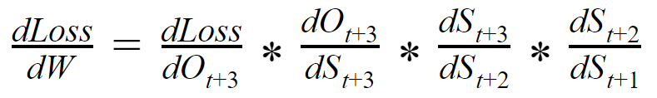
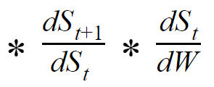
Gradient of Loss w.r.t W using Chain rule
Loss —> O_{t+3} —> S_{t+3} —> S_{t+2} —> S_{t+1} —> S_{t} —> W
BackPropagation through Time (BPTT)

Slide 65
Gradient of Loss w.r.t W using Chain rule
Loss —> O_{t+3} —> S_{t+3} —> S_{t+2} —> S_{t+1} —> S_{t} —> W
Let’s check on this part where ‘W’ is directly involved

Slide 66
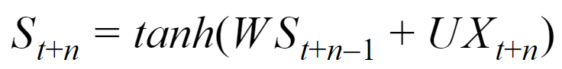
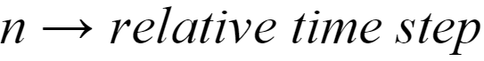
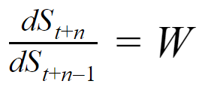
Gradient of S_{t+n} with respect to S_{t+n-1}
Please note tanh gradient will also be calculated.
Gradient always results in ‘W’ (multiplied by tanh gradient)

Slide 67
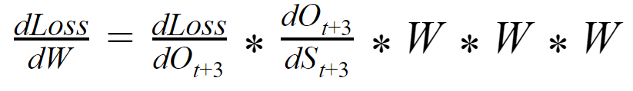
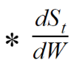
Gradient of Loss w.r.t W using Chain rule
Loss —> O_{t+3} —> S_{t+3} —> S_{t+2} —> S_{t+1} —> S_{t} —> W
Gradient calculation requires repeated multiplication by ‘W’.

Slide 68
Could this be a problem?

Slide 69
Vanishing or Exploding Gradient
(If W is small or large)
Can not remember for long (very short memory)

Slide 70
Hence we do not use RNN (what we described so far).

Slide 71

Solving problems with RNN

Slide 72
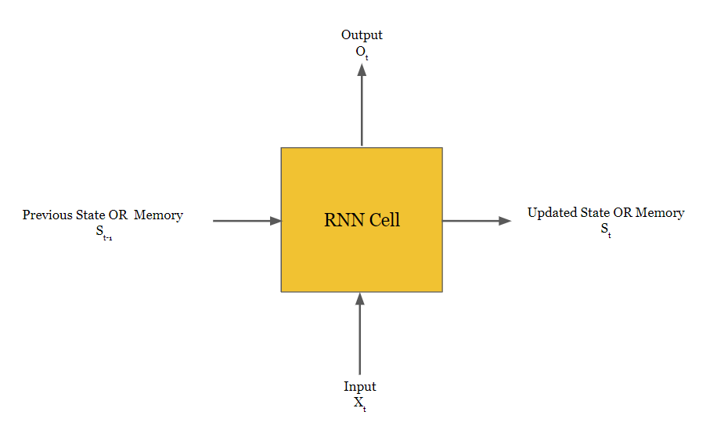
Output
LSTM
Or
GRU
Previous State
OR
Memory
New State
In practice, LSTM or GRU is used instead of Simple RNN
Input

Slide 73

Understanding
Long short term memory
(LSTM)

Slide 74
Both Simple RNN and LSTM
look at one data element at a time
build memory over the sequence
but …
differ in how they build memory
Let’s understand how humans build their memory

Slide 75

We humans keep building our memory throughout our life , we build memory on different things ...e.g
Traveling from home to workplace
Performing office work
Knowledge of Neural networks
So many things ….

Slide 76
For humans, what all operations do we need to do to build memory?
Create
Read
Update
Delete

Slide 77
Based on today’s session, what should be changed in our memory?
Things to forget and to remember
Things to add/update in memory
What are the inputs for building this list?
Our previous memory of neural network
Current input (today’s learning)

Slide 78
Simple RNN Cell
O_{t}
Dense
S_{t-1}
Dense
+
tanh
S_{t}
Old
memory
Updated memory
Dense
x_{t}
Simple RNN tries to perform all memory operations in one shot!

Slide 79
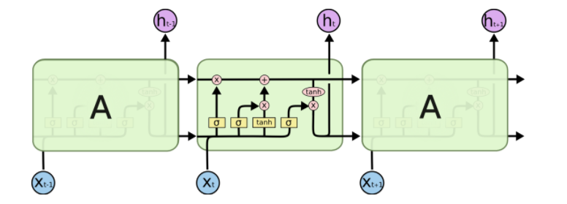
LSTM Cell
LSTM uses different neural networks to perform different Memory operations

Slide 80
Long term memory i.e Cell state
Cell state keeps getting updated as LSTM get to look at new input
To start with, both Cell state and hidden state will be randomly initialized.
Hidden state
LSTM uses two type of memory (compared to one in simple RNN)
A filtered version of Cell state based on current input

Slide 81
Long term memory i.e Cell state
Cell state keeps getting updated as LSTM get to look at new input
[3,1,0,4,-2]
Let’s assume LSTM memory size is 5. We initialize both Cell and Hidden state with some random values
[0.5, 2, 1, 0.1, -3]
Hidden state
LSTM uses two type of memory (compared to one in simple RNN)
A filtered version of Cell state based on current input

Slide 82

How to delete (or forget) things from LSTM memory?

Slide 83
List of things to remember and forget
[1.0, 0.2, 0, 0.9, 0.5]
Prepare list of things to forget and remember
f_{t}
𝛔
What items to forget and remember are based on previous hidden state and current input.
The output of forget gate (f_{t}) will have values between 0 and 1 (due to sigmoid).
Size of h_{t-1} and f_{t} will be same
+
Dense
Dense
h_{t-1}
x_{t}
Hidden state from previous step
Input at current time step
[0.5, 2, 1, 0.1, -3]

Slide 84
[3,1,0,4,-2]
[3.0, 0.2,0, 3.6, -1.0]
Long term memory (Cell state)
C_{t-1}
✖
Cell state after previous step
The output (f_{t}) is then multiplied with cell state:
For values equal to 1 in f_{t}, cell state values will be kept as is (remember things)
For values equal to 0 in f_{t}, cell state values will be set to zeros (forget things)
For values between 0 and 1 in f_{t}, cell state values will be modified (something to remember, something to forget)
[1.0, 0.2, 0, 0.9, 0.5]
f_{t}
𝛔
+
Dense
Dense
LSTM Forget Gate
h_{t-1}
x_{t}
Hidden state from previous step
Input at current time step
[0.5, 2, 1, 0.1, -3]

Slide 85
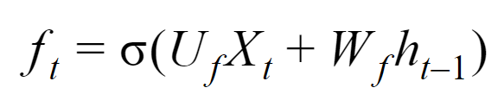
[3,1,0,4,-2]
[3.0, 0.2,0, 3.6, -1.0]
Long term memory (Cell state)
C_{t-1}
✖
Cell state after previous step
[1.0, 0.2, 0, 0.9, 0.5]
f_{t}
𝛔
+
LSTM Forget gate uses two sets of weights
Dense
Dense
h_{t-1}
x_{t}
Hidden state from previous step
Input at current time step
[0.5, 2, 1, 0.1, -3]

Slide 86

How to Update things from LSTM memory?

Slide 87
List of things to add/update to Cell state
Prepare list of things which you want to add and update
[0.9, 0.1, -0.3, 0.6, 1.0]
What items to add and update are based on previous hidden state and current input.
The output (c_{t}) indicates what we want to add/update to long term based on current input.
We can use ‘Relu’ in place of ‘tanh’
c_{t}
tanh
Candidate Cell state
more influenced by from current input
+
Dense
Dense
h_{t-1}
x_{t}
Hidden state from previous step
Input at current time step
[0.5, 2, 1, 0.1, -3]

Slide 88
But not everything from this list will make it to long term memory!
Prepare list of things which you want to add and update
[0.9, 0.1, -0.3, 0.6, 1.0]
What items to add and update are based on previous hidden state and current input.
The output (c_{t}) indicates what we want to add/update to long term based on current input.
We can use ‘Relu’ in place of ‘tanh’
c_{t}
tanh
Candidate Cell state
list of things to add/update, more influenced by from current input
+
Dense
Dense
h_{t-1}
x_{t}
Hidden state from previous step
Input at current time step
[0.5, 2, 1, 0.1, -3]

Slide 89
We have another network which decides what will ‘actually’ be taken forward from the list!
[0.4, 0, 0.9, 1.0, 0.7]
[0.9, 0.1, -0.3, 0.6, 1.0]
i_{t}
c_{t}
𝛔
tanh
Input gate output
Controls what information from add/update list will be taken to Cell state
Candidate Cell state
list of things to add/update, more influenced by from current input
+
+
Dense
Dense
Dense
Dense
h_{t-1}
x_{t}
h_{t-1}
x_{t}
Hidden state from previous step
Input at current time step
Hidden state from previous step
Input at current time step
[0.5, 2, 1, 0.1, -3]

Slide 90
Final list of things to add/update to Cell state
LSTM Input Gate
Responsible for adding information to long term memory
[0.36, 0, -0.27, 0.6, 0.7]
i_{t}*c_{t}
[0.4, 0, 0.9, 1.0, 0.7]
✖
[0.9, 0.1, -0.3, 0.6, 1.0]
i_{t}
c_{t}
𝛔
tanh
Input gate output
Controls what information from add/update list will be taken to Cell state
Candidate Cell state
list of things to add/update, more influenced by from current input
+
+
Dense
Dense
Dense
Dense
h_{t-1}
x_{t}
h_{t-1}
x_{t}
Hidden state from previous step
Input at current time step
Hidden state from previous step
Input at current time step
[0.5, 2, 1, 0.1, -3]
[0.5, 2, 1, 0.1, -3]

Slide 91
[3,1,0,4,-2]
[3.0, 0.2, 0, 3.6, -1.0]
[3.36, 0.2, -0.27, 4.2, -0.3]
C_{t-1}
✖
+
C_{t}
Cell state after previous step
i_{t}*c_{t}
[0.36, 0, -0.27, 0.6, 0.7]
Cell state after Current step
f_{t}
✖
[1.0, 0.2, 0, 0.9, 0.5]
[0.4, 0, 0.9, 1.0, 0.7]
[0.9, 0.1, -0.3, 0.6, 1.0]
i_{t}
c_{t}
𝛔
tanh
Input gate output
Controls what information from add/update list will be taken to Cell state
Candidate Cell state
list of things to add/update, more influenced by from current input
+
+
Dense
Dense
Dense
Dense
LSTM
Input Gate
h_{t-1}
x_{t}
h_{t-1}
x_{t}
Hidden state from previous step
Input at current time step
Hidden state from previous step
Input at current time step
[0.5, 2, 1, 0.1, -3]
[0.5, 2, 1, 0.1, -3]

Slide 92
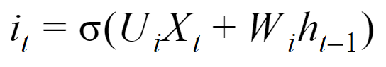
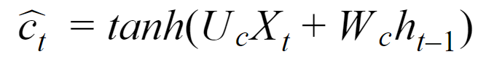
[3,1,0,4,-2]
[3.0, 0.2, 0, 3.6, -1.0]
[3.36, 0.2, -0.27, 4.2, -0.3]
C_{t-1}
✖
+
C_{t}
Cell state after previous step
i_{t}*c_{t}
[0.36, 0, -0.27, 0.6, 0.7]
Cell state after Current step
f_{t}
✖
[1.0, 0.2, 0, 0.9, 0.5]
[0.4, 0, 0.9, 1.0, 0.7]
[0.9, 0.1, -0.3, 0.6, 1.0]
i_{t}
c_{t}
𝛔
tanh
Input gate output
Candidate Cell state
+
+
Dense
Dense
Dense
Dense
LSTM
Input Gate
h_{t-1}
x_{t}
h_{t-1}
x_{t}
Hidden state from previous step
Input at current time step
Hidden state from previous step
Input at current time step
[0.5, 2, 1, 0.1, -3]
[0.5, 2, 1, 0.1, -3]

Slide 93
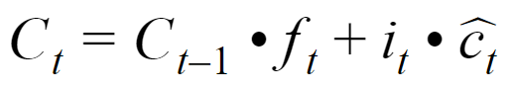
[3,1,0,4,-2]
[3.0, 0.2, 0, 3.6, -1.0]
[3.36, 0.2, -0.27, 4.2, -0.3]
C_{t-1}
✖
+
C_{t}
Cell state after previous step
Cell state after Current step
f_{t}
i_{t}*c_{t}
[1.0, 0.2, 0, 0.9, 0.5]
[0.36, 0, -0.27, 0.6, 0.7]
New Cell State

Slide 94

Reading Cell state to build hidden state?

Slide 95
How much information we need from each item in Cell state
Prepare list of things which we want to read from Cell state
[0, 1.0, 0.7, 0.1, 0.3]
o_{t}
𝛔
Output gate output
Controls what information from Cell state should be read to build hidden state
+
Dense
Dense
h_{t-1}
x_{t}
Hidden state from previous step
Input at current time step

Slide 96
[3,1,0,4,-2]
[3.0, 0.2, 0, 3.6, -1.0]
[3.36, 0.2, -0.27, 4.2, -0.3]
C_{t-1}
✖
+
C_{t}
Cell state after previous step
Cell state
f_{t}
i_{t}*c_{t}
[1.0, 0.2, 0, 0.9, 0.5]
[0.36, 0, -0.27, 0.6, 0.7]
[0, 1.0, 0.7, 0.1, 0.3]
Tanh / Relu
o_{t}
[3.36, 0.2, 0, 4.2, 0]
With Relu
𝛔
X
Output gate output
Controls what information from Cell state should be read to build hidden state
+
[0, 0.2, 0, 0.42, 0]
h_{t}
LSTM Output Gate
Responsible for building hidden state from Cell state
Dense
Dense
New hidden state
h_{t-1}
x_{t}
Hidden state from previous step
Input at current time step

Slide 97
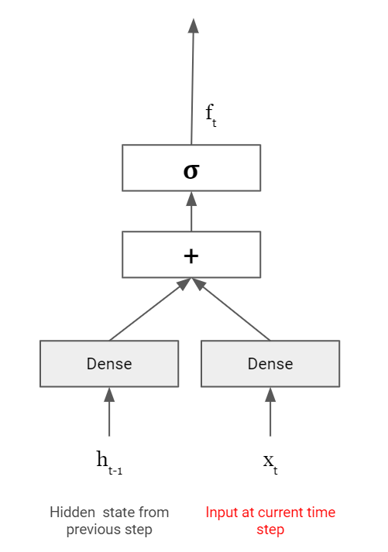
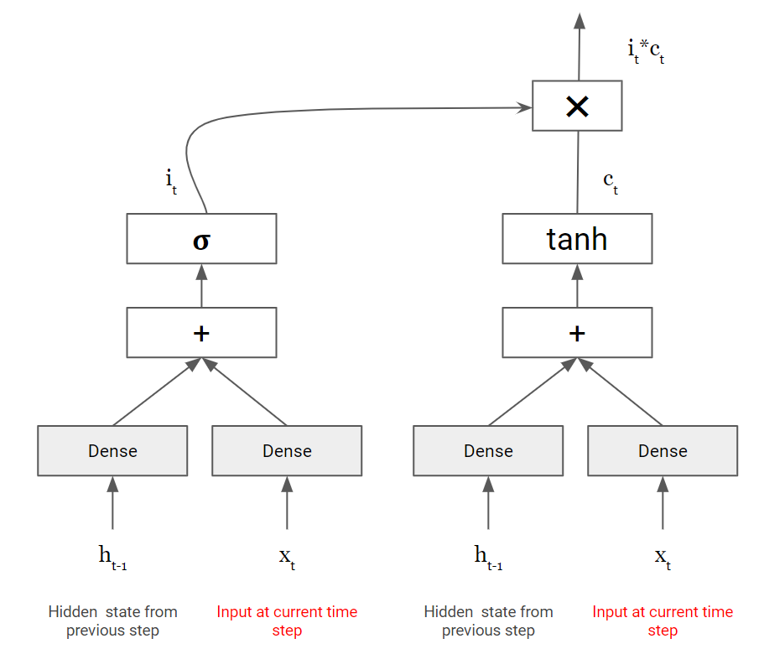
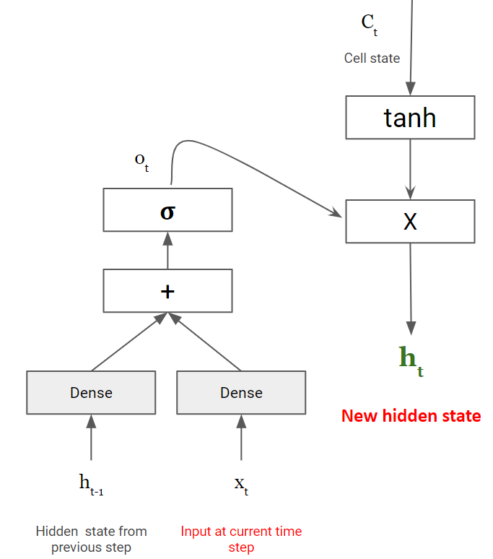
LSTM Cell
[3,1,0,4,-2]
[3.0, 0.2, 0, 3.6, -1.0]
[3.36, 0.2, -0.27, 4.2, -0.3]
C_{t-1}
✖
+
Cell state after previous step
[0.4, 0, 0.9, 1.0, 0.7]
[0.36, 0, -0.27, 0.6, 0.7]
[1.0, 0.2, 0, 0.9, 0.5]
[0.9, 0.1, -0.3, 0.6, 1.0]
[0, 1.0, 0.7, 0.1, 0.3]
[3.36, 0.2, 0, 4.2, 0]
With Relu
[0, 0.2, 0, 0.42, 0]
Forget Gate
Controls things to remember and forget from memory
Input Gate
Controls what to add / update to memory
Output Gate
Controls what to read from memory

Slide 98
LSTM Cell
C_{t-1}
✖
+
Cell state after previous step
Forget Gate
Controls things to remember and forget from memory
Input Gate
Controls what to add / update to memory
Output Gate
Controls what to read from memory

Slide 99
LSTM Cell
Another view of the same

Slide 100
LSTM Summary
Use two states or memory
Cell State : used to store Long term memory.
Hidden State : A filtered version of Cell state, used to build final output
Three (3) Gates
What is a ‘Gate’?
A Gate controls flow of information to/from long term memory (Cell state)
What are three gates in LSTM?
Forget Gate : Controls what to forget and what to keep in long term memory (Cell state)
Input Gate : Controls what to add to long term memory
Output Gate : What information from the Cell state will be sent to hidden state

Slide 101
What is the output of LSTM?
Hidden state
and/or
Cell State

Slide 102
Backpropagation in LSTM

Slide 103
Optimizer
LOSS
Start with Random Memory
O/P Layer
c₀
LSTM
time step : 1
c₁
LSTM
time step : 2
c₂
LSTM
time step : 3
c₃
LSTM
time step : 4
c₄
DENSE
h₀
h₁
h₂
h₃
h₄
O
(Prediction)
x₁
x₂
x₂
x₂
Forward Propagation of data in LSTM

Slide 104
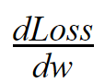
Let’s calculate ….
Where ‘w’ is any of the weights in LSTM

Slide 105
Understanding relationship between Loss and ‘w’
Optimizer
LOSS
O/P Layer
c₀
LSTM
time step : 1
c₁
LSTM
time step : 2
c₂
LSTM
time step : 3
c₃
LSTM
time step : 4
c₄
DENSE
O
(Prediction)
h₀
h₁
h₂
h₃
h₄
w
x₁
x₂
x₂
x₂
Loss → O → h₄ → c₄ → c₃ → c₂ → c₁ → w

Slide 106
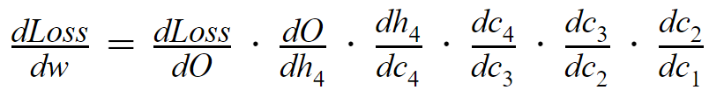
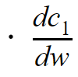
Let’s check on gradient of c_{t} with c_{t-1}

Slide 107
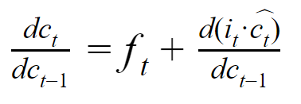
Calculating updated Cell state from previous Cell state
Let’s calculate gradient of c_{t} with c_{t-1}

Slide 108
Forget gate output...between 0 and 1
Additional gradient...can be any value... different at different time step . . .
Together, these gradient terms allow LSTM to reduce vanishing gradient problem.

Slide 109
Gradient in LSTM
Each of these values can be less than 1 or more than 1 ...reducing chance of vanishing gradient

Slide 110
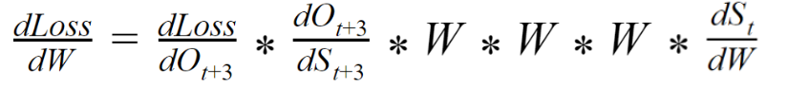
Compare with … Gradient in Simple RNN
Multiplication of W lot of times creates vanishing gradient or exploding gradient.

Slide 111

Where all we can use RNNs?

Slide 112

Output
R
N
N
R
N
N
R
N
N
R
N
N
Sentiment analysis
Input
Input
Input
Input
Many inputs, one output

Slide 113
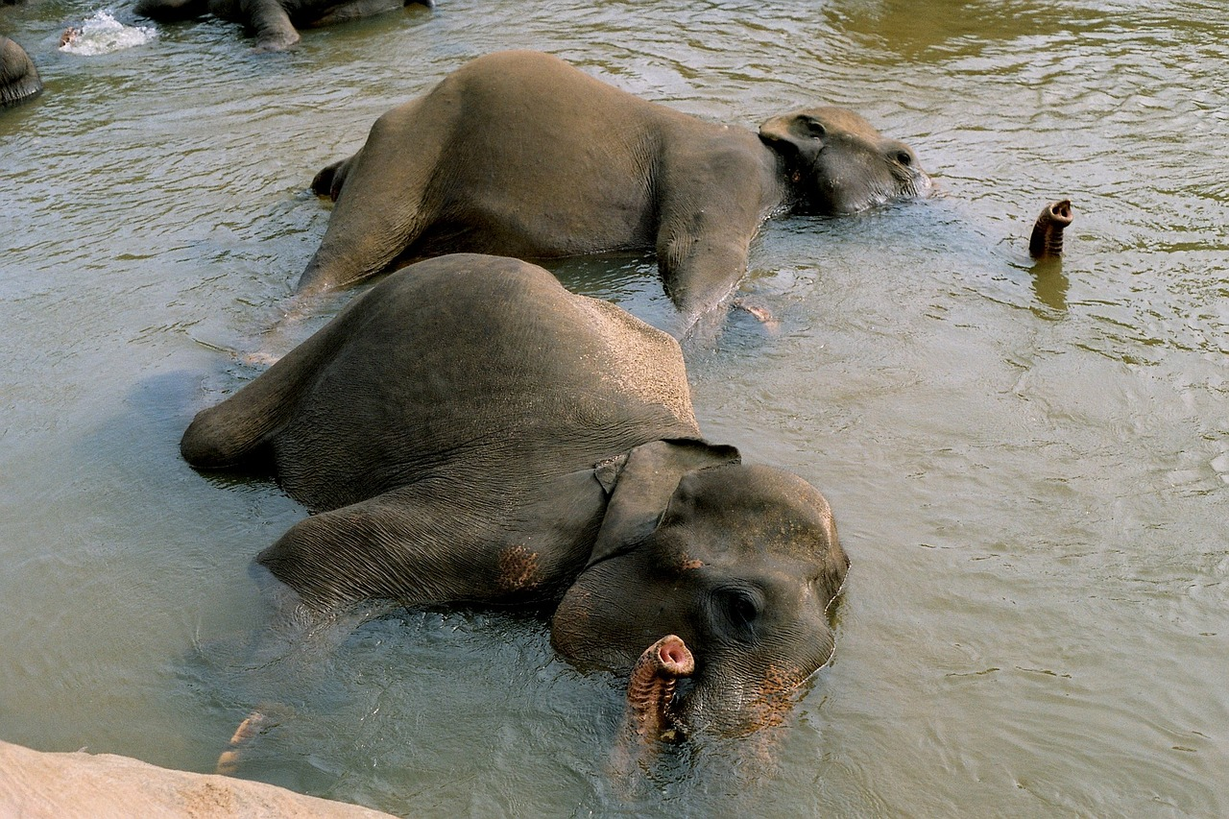
Output
Output
Output
Output
Image Captioning
R
N
N
R
N
N
R
N
N
R
N
N
One input, multiple outputs
Elephants taking bath
Input

Slide 114
Output
Output
Output
Output
R
N
N
R
N
N
R
N
N
R
N
N
R
N
N
R
N
N
R
N
N
Many inputs, Many outputs
e.g. Language Translation
Input
Input
Input
Input

Slide 115
LSTM for Sentiment Analysis
Movie reviews

Slide 116
Dense
Probability of Positive sentiment
RNN
(t =0)
RNN
(t =1)
RNN
(t =2)
RNN
(t =3)
The
Embedding
movie
Embedding
Review Text - 4 words
was
Embedding
great
Embedding
RNN for Sentiment Analysis

Slide 117
Backup

Slide 118
N-gram Language Models
What is n-gram?
n-gram is a chunk on n-consecutive words
Unigrams : “the”, “rain”, “just”, “stopped”, “and”, “the”, “sky”, “is”
Bigrams : “the rain”, “rain just”, “just stopped”, “stopped and”, …,”sky is”
Trigrams : “the rain just”, “rain just stopped”,...,”the sky is”
4-grams : “the rain just stopped”, “rain just stopped and”,..., “and the sky is”

Slide 119
N-gram Language Models ...
How does n-gram model work?
Assume that next word is dependent on preceding n-1 words
e.g Next word is dependent on last 3 words “the sky is”
From a large corpus, collect frequency metrics for n-1 grams
e.g How often “the sky is” appears in the corpus (simple count)
Collect frequency of n-grams which have first n-1 words same as previous step
e.g How often n-grams like “the sky is blue” or “the sky is dark” or “the sky is clear” appear in the corpus
Divide different n-grams frequencies (step 1.3) with n-1 gram frequency (step 1.2) to get next word probability.
In the corpuse, “the sky is” appears 100 times
“the sky is blue” 47 times, “the sky is dark” 33 times and “the sky is clear” appears 20 times
Based on probability, the word will be blue in this case (47% probability)

Slide 120
Potential issues with n-gram models

Slide 121
Issues with N-gram Language Models
Need to store count of all possible n-grams i.e model size is huge
Increasing ‘n’ can make model size very very big
Sparsity Problem
What if “the sky is” never occured in corpus
We can then use ‘sky is’ as a potential solution in this case (called backoff)
The problem becomes worse when we increase ‘n’

